Slide 1
Rate my course
What does the students think about KU courses, lets find out

Slide 2
Page Elements:
Search bar: Search for a course, teacher year
How it works:
When a user searches for course, the corresponding teacher and year, it allows them to select it and rate the course.

Slide 3
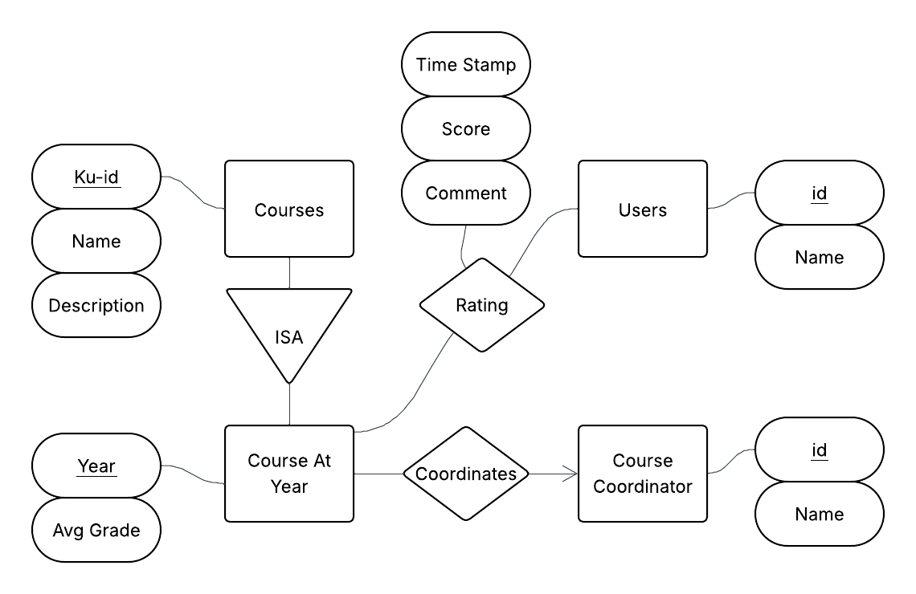

Slide 4
